Slide 1
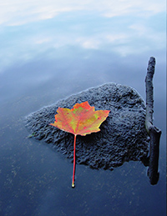
Meditation
Is More Than
You Think
Complimentary Introductory
Evening of Q&A
Tuesday, January 29
6:30 – 8:00 p.m.
Course Dates
8 Tuesday Evenings
February 5 – March 26
6:00 – 8:30 pm
An introductory course providing a sampling of various modalities
of meditation: mantras, sound, movement, breathing, and more.
Remove the mystery from meditation. Explore and experience many forms of meditation. Join us and discover the form of meditation you would like to continue to practice to uplift your life!
Course Investment: $225 + Books (scholarships available);
$100 for anyone who has previously taken this course and would like to take it again
(course materials not provided)
Two Required textbooks :
“An Easy Guide to Meditation” by Roy Eugene Davis , and one of the following:
“How to Meditate” by Lawrence LeShan or “Journey of Awakening” by Ram Dass
Course Instructors: Karen Valera-Sherman, RScP; Christina Young, RScP;
and Cindy Hensley, RScP
Course location: Alaska Center for Spiritual Living, 929 E. 81st, off of Old Seward
Highway near Dimond Blvd. (behind Fastenal) office: 522-0940 www.cslalaska.org

